Slide 1
PILGRIM & ASSOCIATES
KEY FINDINGS & RECOMMENDATIONS
UNIVERSITY OF NEW MEXICO CLIMATE ASSESSMENT ON SEXUAL VIOLENCE
IN STUDENT HOUSING & ATHLETICS PROGRAMS
FALL ‘2014

Slide 2
Mandate from president frank was clear
Find out what climate and attitudes about sexual violence at UNM are in housing and athletics
Tell UNM if we are doing something wrong or have a problem that needs fixing
Tell UNM what we are doing well
Make any suggestions for improvement you believe are warranted

Slide 3
Engagement consistent with best practice to have independent objective entity perform climate assessment
KEY BENEFIT
  Interview subjects honest and forthcoming with their viewpoints with objective 3rd party.

Slide 4

P&A INDEPENDENT & OBJECTIVE
No stake in a particular outcome and no preconceived opinions.

Slide 5
METHODOLOGY
  One-on-one interviews
  Focus group meetings
  Online survey

Slide 6
KEY FINDINGS
Aware UNM making a commitment to education and prevention programs
Aware of the risks associated with sexual violence
Most feel safe

Slide 7
KEY FINDINGS
Exceptions to feeling safe related to time of day and geography
Limited interactions with and understanding of UNM policies and procedures

Slide 8
POLICIES & PROCEDURES ON SEXUAL VIOLENCE REQUIRE IMPROVEMENT
Clear statement on zero tolerance for sexual violence
Fewer and more streamlined policies and procedures for reporting and handling incidents
Expanded and more meaningful education and training of entire UNM constituency groups

Slide 9
POLICIES & PROCEDURES ON SEXUAL VIOLENCE REQUIRE IMPROVEMENT
Emphasis on staff training on obligation to report
Enhanced equal and balanced treatment of alleged victim and alleged perpetrator
Expanded Clery Act reporting

Slide 10

POLICIES & PROCEDURES ON SEXUAL VIOLENCE REQUIRE IMPROVEMENT
Confusion and misunderstanding of where to report
Focus of preventive education and training primarily with staff and student athletes

Slide 11
University of new Mexico's REPORTED sexual assault FIGURES INDICATE AN INCIDENT PREVALANCE EQUAL TO OR less than other similarly-sized universities

Slide 12
Institution by ‘2014 enrollment size (ascending)

Slide 13
Total Sex Offenses by year
UNM

Slide 14
Total sex offenses by year (similar size)
UNM

Slide 15
Total sex offenses by location

Slide 16
Sex offenses by location (University of new Mexico)

Slide 17
Key additional recommendations
Simplify policies and procedures to make user-friendly, plain English and easily accessible
Improve security environment

Slide 18

Key additional recommendations…
Ensure procedures are fair and alleged victim and alleged perpetrator have equal opportunity to enjoy the benefits of their education

Slide 19
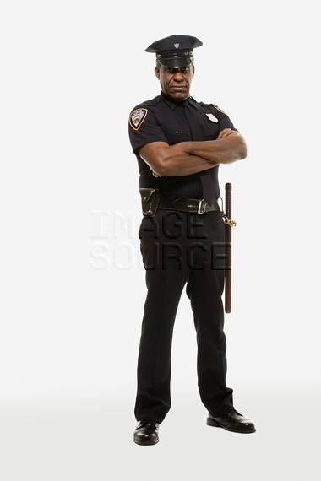
Key additional recommendations . . .
Make UNMPD/security initiatives more visible and effective with preventive measure.
Embrace challenge of a public institution with a predominately commuter campus social culture safeguarding student off campus

Slide 20
Key additional recommendations . . .
Intensify training’s emphasis on staff obligations to prevent and report incidents of sexual violence, and distinction between mandatory reporters and those who maintain information as confidential.
Seek to remove obstacles that prevent students, faculty or staff from reporting an incident of sexual violence.

Slide 21



Key additional recommendations . . .
Extend social relationship/life skills education programs throughout students’ entire college experience.

Slide 22
Key additional recommendations . . .
POLICIES & PROCEDURES ON SEXUAL VIOLENCE REQUIRE IMPROVEMENT

Slide 23
Stopping SEXUAL VIOLENCE IS AN ONGOING PROCESS . . . TO BE CONTINUED
Thank You

